Slide 1
Learn Like a GEM
Subject: Computing
Lesson: Numbers and Data : The SUM function-(Theory)
Date: 30-04-2026

Slide 2

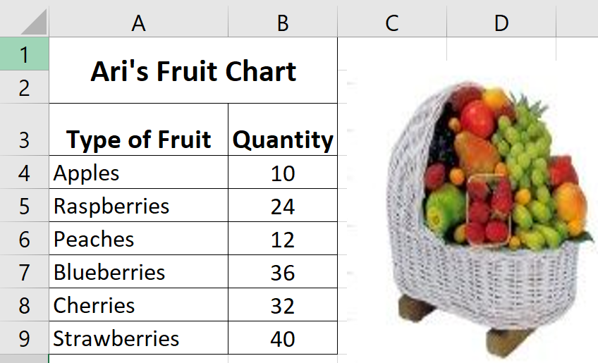
5 mins
Each square box in a Excel is called as __________
Identify the cell reference of Raspberries_______
3. Observe the spreadsheet and write one label and one value_________
Notes:
Prepare relevant tasks – Design a short (3–5 min) retrieval task that prompts active recall from memory, drawing on knowledge from the last lesson, previous units, and/or prerequisite content
Display clearly – Ensure the task is visible and ready for students as they enter the classroom/start the lesson
Establish a routine – Consistently have students start the Do Now immediately without prompting, making it a seamless part of the classroom culture
Monitor and guide – Circulate the room while students work, offering support where needed
Review quickly – Once completed, briefly go over the activity to address misconceptions, share correct answers, or engage students in peer or self-assessment

Slide 3


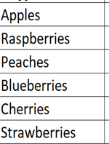
Answers
Each square box in a Excel is called as __cell________
Identify the cell reference of Raspberries___A5____
Observe the spreadsheet and write one label and one value.
Labels: Value:
Ari’s fruit chart
Type of fruit
Quantity
Notes:
Prepare relevant tasks – Design a short (3–5 min) retrieval task that prompts active recall from memory, drawing on knowledge from the last lesson, previous units, and/or prerequisite content
Display clearly – Ensure the task is visible and ready for students as they enter the classroom/start the lesson
Establish a routine – Consistently have students start the Do Now immediately without prompting, making it a seamless part of the classroom culture
Monitor and guide – Circulate the room while students work, offering support where needed
Review quickly – Once completed, briefly go over the activity to address misconceptions, share correct answers, or engage students in peer or self-assessment

Slide 4
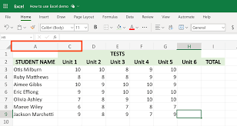
Knowledge Components
By the end of this lesson, you will be able to
Explain what a spreadsheet function is and what sum means.
Cell reference is the name of the cell. It is made of a column letter and row number
e.g.A1, B3, F7
A function is a command that uses values in cells to calculate a new value.
Sum means adding a list or range of numbers together.
The list of numbers in the SUM formula is known as Range.
Notes:
Learning Outcomes
Identify the desired skill – Determine the specific skill or ability students should demonstrate by the end of the lesson. Start with “By the end of this lesson, you will be able to (verb)…”
Align with knowledge components – Consider the knowledge necessary to achieve the learning outcome and apply the skill effectively
Communicate the outcome – Share the learning outcome at the start of the lesson, ensuring students understand what they are working towards
To Know
Create a clear list – Develop a concise list of the knowledge components when planning the lesson
Introduce the components – Present the knowledge components at the beginning of the lesson, clearly explaining the importance of each component, how they connect to one another and directly support in achieving the learning outcome
Integrate into instruction – Incorporate the knowledge components throughout the lesson, reinforcing them during discussions, activities, and assessments

Slide 5
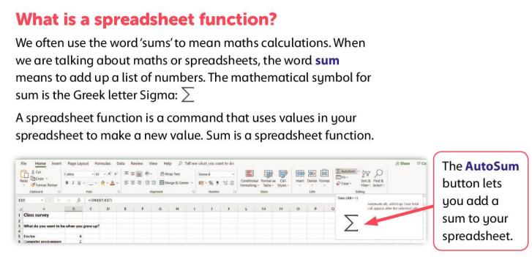
Notes:
Model the task (I Do) – Demonstrate the skill while thinking aloud and naming the steps; model your thinking and not just the procedure

Slide 6
Read Like a GEM
EXCEL FORMULAS
In Microsoft Excel you must have an equal's sign ( = ) as the first character in a cell that contains a formula.
The = sign tells excel that the contents of the cell is a formula
Without the = sign, the formula will not calculate anything. It will simply display the text of the formula.

Slide 7
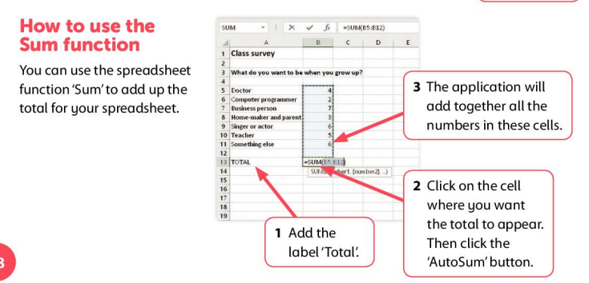
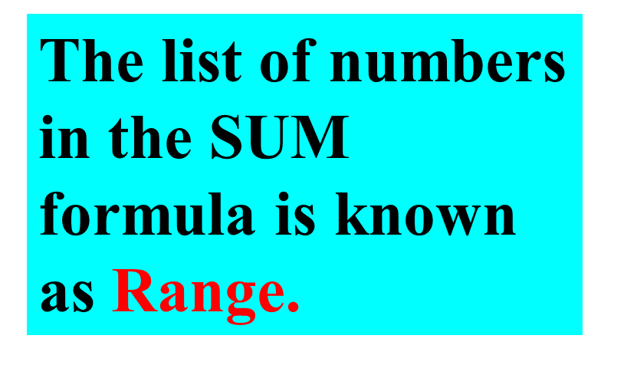
Notes:
Model the task (I Do) – Demonstrate the skill while thinking aloud and naming the steps; model your thinking and not just the procedure

Slide 8
SUM and AUTOSUM
AUTOSUM | SUM
1.AUTOSUM allows to quickly and automatically calculate the sum of a range of numbers. | 1. SUM function is also used to calculate the sum of a range of numbers but only with SUM Formula.
2. AUTOSUM eliminates the need for manual calculation, saving your time and effort. | 2. We need to write the SUM formula manually to calculate the total.
Notes:
Model the task (I Do) – Demonstrate the skill while thinking aloud and naming the steps; model your thinking and not just the procedure

Slide 9

Imagine your friend thinks SUM only works for two numbers and that a function is just any number in Excel.
Write 2–3 sentences to:
    Correct your friend’s mistake about functions
    Explain what SUM really means and what it can do
    👉 Start your answer with:
    “A spreadsheet function is…”
Notes:
Engage in guided practice (We Do) – Work together with students using another example; ask questions, probe thinking, provide prompts, and give feedback. Be explicit about what students should be doing during this stage

Slide 10



30-04-2026
The Sum Function
LO: Explain what a spreadsheet function is and what sum means
A shop owner records daily sales in a spreadsheet. Which function should be used to find total sales for the week?
      A. Average
      B. Count
      C. SUM
Notes:
Facilitate independent practice (You Do) – Allow students to complete the task independently, providing minimal guidance. Use Affirmative Checking and offer constructive feedback to reinforce learning and address any misconceptions

Slide 11

20 mins
2. A list of numbers in the SUM formula is known as ……………
      Label
      Formula
      Range
Notes:
Facilitate independent practice (You Do) – Allow students to complete the task independently, providing minimal guidance. Use Affirmative Checking and offer constructive feedback to reinforce learning and address any misconceptions

Slide 12
20 mins
3. Every formula in MS Excel starts with
      +
      =
      /
Notes:
Facilitate independent practice (You Do) – Allow students to complete the task independently, providing minimal guidance. Use Affirmative Checking and offer constructive feedback to reinforce learning and address any misconceptions

Slide 13
SUM
Range
=
Notes:
Set clear expectations – Before students begin work, outline the task and explain what a strong response looks like, ensuring students understand what you will be looking for
Circulate strategically – Move around the classroom deliberately, ensuring that all students know you will be checking their work to offer real-time support; position yourself where you can observe multiple students at once
Offer praise and actionable feedback – Offer specific guidance and encourage independence by fostering self-correction and deeper thinking (name error, ask them to revise it, follow up); give quick feedback (symbols, code, colour)
Follow up – Return to students to see if they implemented your feedback and made progress

Slide 14
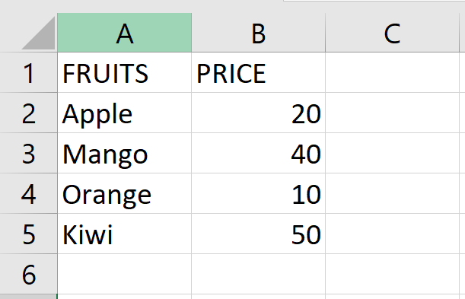
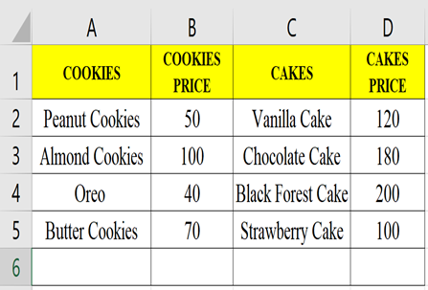

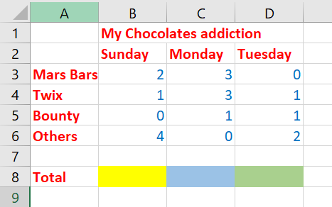
20 mins
Practice more | Try Alone | Challenge 1
Match the following | Observe the table and answer the below questions. 1. Write the SUM formula to add the price of the fruits 2. Which cell you will write the formula to add the price? | Sara wants to add the total price of Cakes. How AUTOSUM will help her to calculate the cake price . Write the steps Create the SUM formula to find the total number of chocolates eaten on Sunday and Monday. Mention the cell name you will write the formula to calculate.
Terms | Meaning
SUM function | Quickly inserts the SUM function
AutoSum (Σ) | Values
The SUM function can add only | Adds numbers in cells
Notes:
Facilitate independent practice (You Do) – Allow students to complete the task independently, providing minimal guidance. Use Affirmative Checking and offer constructive feedback to reinforce learning and address any misconceptions

Slide 15



20 mins
Practice more | Try Alone | Challenge 1
Match the following | Observe the table and answer the below questions. 1. =SUM(B2:B5) 2. The formula has to be written in the cell B6 | Sara wants to add the total price of Cakes. How AUTOSUM will help her to calculate the cake price . Write the steps AUTOSUM will help Sara quickly calculate the total price of cakes by automatically adding all the values in the “Cakes Price” column (Column D) 1. Sara has to click on the cell D6. 2. Then click on the AUTOSUM button from Home tab or Formula tab. 3. AUTOSUM will automatically select the range to add the numbers. Create the SUM formula to find the total number of chocolates eaten on Sunday and Monday. Mention the cell name you will write the formula to calculate. Sunday B8 =sum(B3:B6) Monday C8 =sum(C3:C6)
Terms | Meaning
SUM function | Quickly inserts the SUM function
AutoSum (Σ) | Values
The SUM function can add only | Adds numbers in cells
Notes:
Facilitate independent practice (You Do) – Allow students to complete the task independently, providing minimal guidance. Use Affirmative Checking and offer constructive feedback to reinforce learning and address any misconceptions

Slide 16

5 mins
Answer the following
A class survey has missing numbers in some cells. What will SUM do?
Show an error every time
Ignore empty cells and add the rest
Count text as numbers
Refuse to calculate
2. If a number in the range changes, the SUM total will update automatically.
True/ False
3. Before clicking AutoSum, the user should select the __________ where the total should be displayed.
Notes:
1. Create targeted questions – Design no more than 1-3 brief and focused questions/prompts that assess the lesson’s core knowledge or skills
2. Distribute at the end – Share the exit tickets at the end of the lesson, ensuring everyone completes them
3. Collect and review – Gather responses and quickly analyse responses to gauge overall understanding and individual student needs
4. Provide feedback – Use the exit ticket data to give immediate feedback
5. Plan next steps – Adapt future lessons based on patterns or misconceptions identified through the exit tickets

Slide 17
Thank you

