Slide 1
Learn Like a GEM
Subject: Computing
Lesson: Numbers and Data : The Sum function and subtract formula(LAB)
Date: 30-04-2026

Slide 2

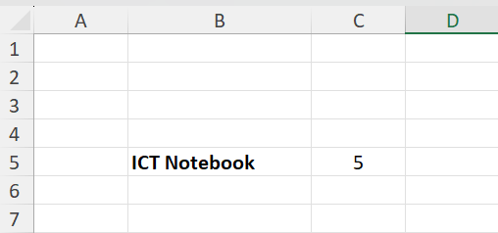
5 mins
A spreadsheet is made up of rows and _________
Name the label : _________
value : __________
3. Give the cell reference of “ICT notebook”
Notes:
Prepare relevant tasks – Design a short (3–5 min) retrieval task that prompts active recall from memory, drawing on knowledge from the last lesson, previous units, and/or prerequisite content
Display clearly – Ensure the task is visible and ready for students as they enter the classroom/start the lesson
Establish a routine – Consistently have students start the Do Now immediately without prompting, making it a seamless part of the classroom culture
Monitor and guide – Circulate the room while students work, offering support where needed
Review quickly – Once completed, briefly go over the activity to address misconceptions, share correct answers, or engage students in peer or self-assessment

Slide 3

Answers
A spreadsheet is made up of rows and columns
Name the label : ICT notebook
value :5
3. Give the cell reference of “ICT notebook” B5
Notes:
Prepare relevant tasks – Design a short (3–5 min) retrieval task that prompts active recall from memory, drawing on knowledge from the last lesson, previous units, and/or prerequisite content
Display clearly – Ensure the task is visible and ready for students as they enter the classroom/start the lesson
Establish a routine – Consistently have students start the Do Now immediately without prompting, making it a seamless part of the classroom culture
Monitor and guide – Circulate the room while students work, offering support where needed
Review quickly – Once completed, briefly go over the activity to address misconceptions, share correct answers, or engage students in peer or self-assessment

Slide 4
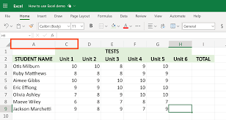
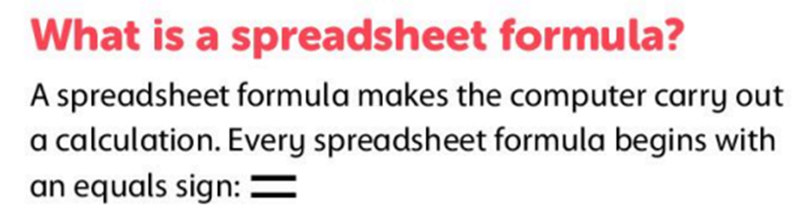
Knowledge components
By the end of this lesson, you will be able to
Use Excel formulas to add and subtract numbers correctly.
Cell reference is the name of the cell. It is made of a column letter and row number
e.g.A1, B3, F7
A function is a command that uses values in cells to calculate a new value.
Sum means adding a list or range of numbers together.
The list of numbers in the SUM formula is known as Range.
Notes:
Learning Outcomes
Identify the desired skill – Determine the specific skill or ability students should demonstrate by the end of the lesson. Start with “By the end of this lesson, you will be able to (verb)…”
Align with knowledge components – Consider the knowledge necessary to achieve the learning outcome and apply the skill effectively
Communicate the outcome – Share the learning outcome at the start of the lesson, ensuring students understand what they are working towards
To Know
Create a clear list – Develop a concise list of the knowledge components when planning the lesson
Introduce the components – Present the knowledge components at the beginning of the lesson, clearly explaining the importance of each component, how they connect to one another and directly support in achieving the learning outcome
Integrate into instruction – Incorporate the knowledge components throughout the lesson, reinforcing them during discussions, activities, and assessments

Slide 5
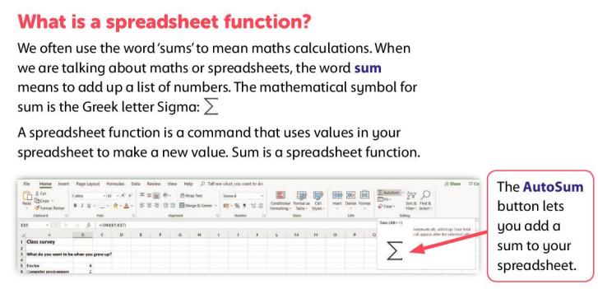

Slide 6
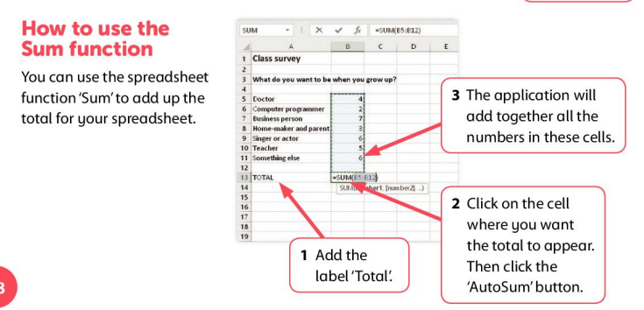


Slide 7
Read Like a GEM
AUTOSUM allows to quickly and automatically calculate the sum of a range of numbers.
The list of numbers in the SUM formula is known as Range.
SUM function is also used to calculate the sum of a range of numbers but only with SUM Formula.
We need to write the SUM formula manually to calculate the total.

Slide 8
Model to use the Sum function to add a series of numbers and how to subtract numbers
Model how to format the document.

Slide 9


Imagine your friend is typing answers in Excel instead of using formulas.
Write 2–3 sentences to explain:
    How to use formulas to add and subtract numbers correctly
    Why using formulas is better than typing the answers
    👉 Start your answer with:
    “In Excel, I use a formula to…”
    “Using formulas in Excel is better because…”
Notes:
Engage in guided practice (We Do) – Work together with students using another example; ask questions, probe thinking, provide prompts, and give feedback. Be explicit about what students should be doing during this stage

Slide 10
Click on Google Chrome.
Type Padlet link.
Download Excel file.
Start with Task1 progress to Task2 and Task3.

Slide 11
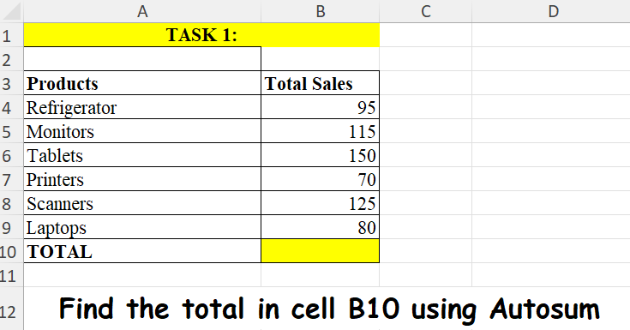


Slide 12
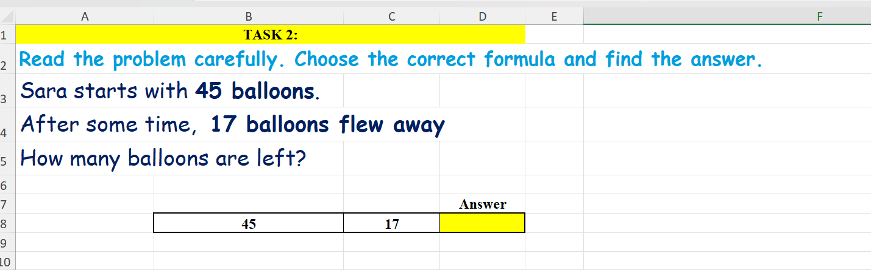

Slide 13
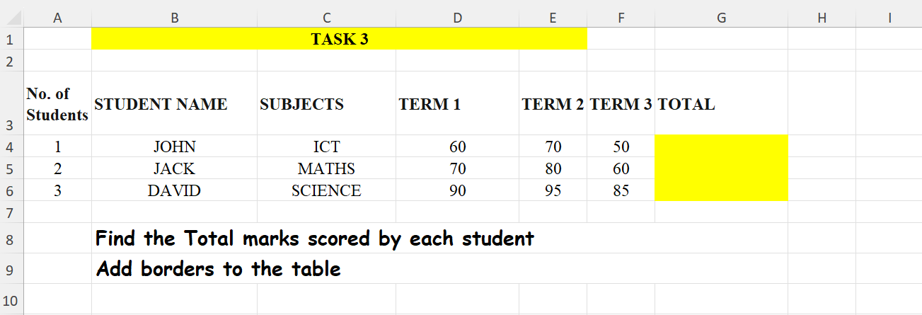

Slide 14
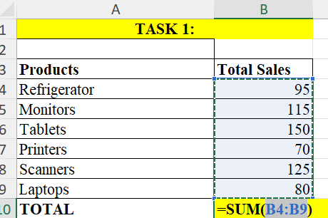
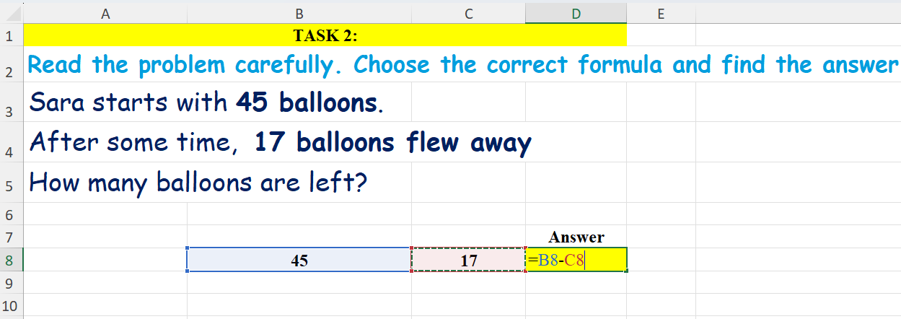
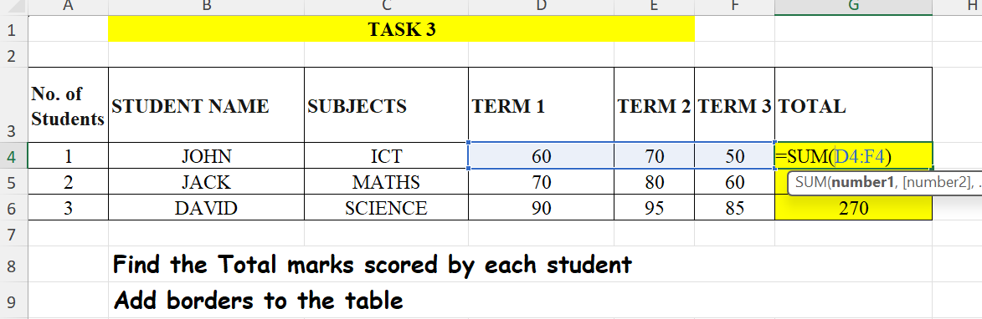
Notes:
Set clear expectations – Before students begin work, outline the task and explain what a strong response looks like, ensuring students understand what you will be looking for
Circulate strategically – Move around the classroom deliberately, ensuring that all students know you will be checking their work to offer real-time support; position yourself where you can observe multiple students at once
Offer praise and actionable feedback – Offer specific guidance and encourage independence by fostering self-correction and deeper thinking (name error, ask them to revise it, follow up); give quick feedback (symbols, code, colour)
Follow up – Return to students to see if they implemented your feedback and made progress

Slide 15

5 mins
In Excel, every formula must start with the = sign.
True / False
Which formula correctly adds the values in cells A1, A2, and A3?(2 options)
=SUM(A1:A3)
=SUM(A1:A3)
=A1-A2-A3
SUM(A1:A3)
Write the Excel formula to subtract 7 (cell B2) from 15 (cell A2).
Notes:
1. Create targeted questions – Design no more than 1-3 brief and focused questions/prompts that assess the lesson’s core knowledge or skills
2. Distribute at the end – Share the exit tickets at the end of the lesson, ensuring everyone completes them
3. Collect and review – Gather responses and quickly analyse responses to gauge overall understanding and individual student needs
4. Provide feedback – Use the exit ticket data to give immediate feedback
5. Plan next steps – Adapt future lessons based on patterns or misconceptions identified through the exit tickets

Slide 16
5 mins
In Excel, every formula must start with the = sign.
True / False
Which formula correctly adds the values in cells A1, A2, and A3?(2 options)
=A1+A2+A3
=SUM(A1:A3)
=A1-A2-A3
SUM(A1:A3)
Write the Excel formula to subtract 7 (cell B2) from 15 (cell A2).
=A2-B2
Notes:
1. Create targeted questions – Design no more than 1-3 brief and focused questions/prompts that assess the lesson’s core knowledge or skills
2. Distribute at the end – Share the exit tickets at the end of the lesson, ensuring everyone completes them
3. Collect and review – Gather responses and quickly analyse responses to gauge overall understanding and individual student needs
4. Provide feedback – Use the exit ticket data to give immediate feedback
5. Plan next steps – Adapt future lessons based on patterns or misconceptions identified through the exit tickets

Slide 17
Thank you

