Slide 1
Learn Like a GEM
Subject: URDU
Lesson:حروف تہجی (ب) کا خاندان
Date: 7-9-2026

Slide 2
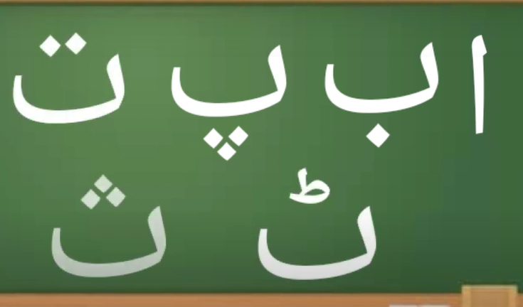
Notes:
Prepare relevant tasks – Design a short (3–5 min) retrieval task that prompts active recall from memory, drawing on knowledge from the last lesson, previous units, and/or prerequisite content
Display clearly – Ensure the task is visible and ready for students as they enter the classroom/start the lesson
Establish a routine – Consistently have students start the Do Now immediately without prompting, making it a seamless part of the classroom culture
Monitor and guide – Circulate the room while students work, offering support where needed
Review quickly – Once completed, briefly go over the activity to address misconceptions, share correct answers, or engage students in peer or self-assessment

Slide 3
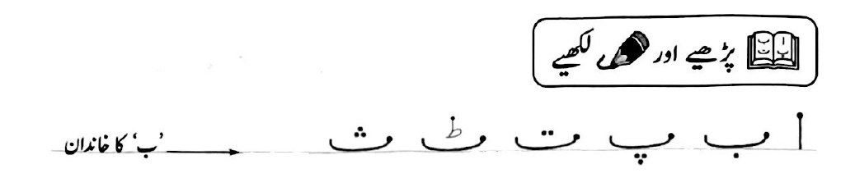
نتائج
ب کا خاندان
ا سے ث تک کی آواز اور حرف میں فرق سمجھ سکیں گے۔
 | حروف تہجی
alif | ا
be | ب
pe | پ
te | ت
Te | ٹ
Se | ث
Notes:
Learning Outcomes
Identify the desired skill – Determine the specific skill or ability students should demonstrate by the end of the lesson. Start with “By the end of this lesson, you will be able to (verb)…”
Align with knowledge components – Consider the knowledge necessary to achieve the learning outcome and apply the skill effectively
Communicate the outcome – Share the learning outcome at the start of the lesson, ensuring students understand what they are working towards
To Know
Create a clear list – Develop a concise list of the knowledge components when planning the lesson
Introduce the components – Present the knowledge components at the beginning of the lesson, clearly explaining the importance of each component, how they connect to one another and directly support in achieving the learning outcome
Integrate into instruction – Incorporate the knowledge components throughout the lesson, reinforcing them during discussions, activities, and assessments

Slide 4
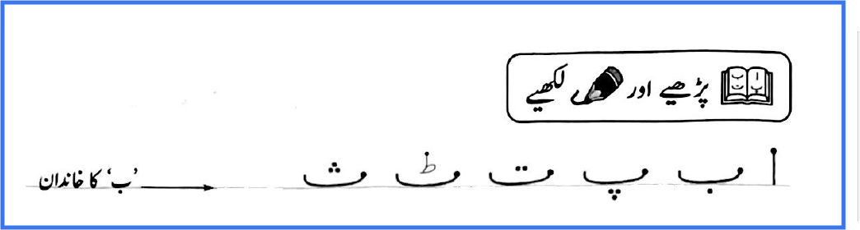
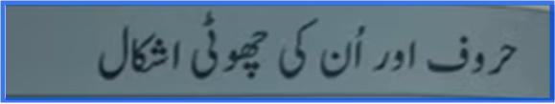
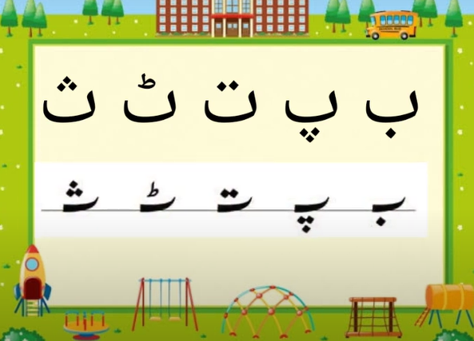

Slide 5
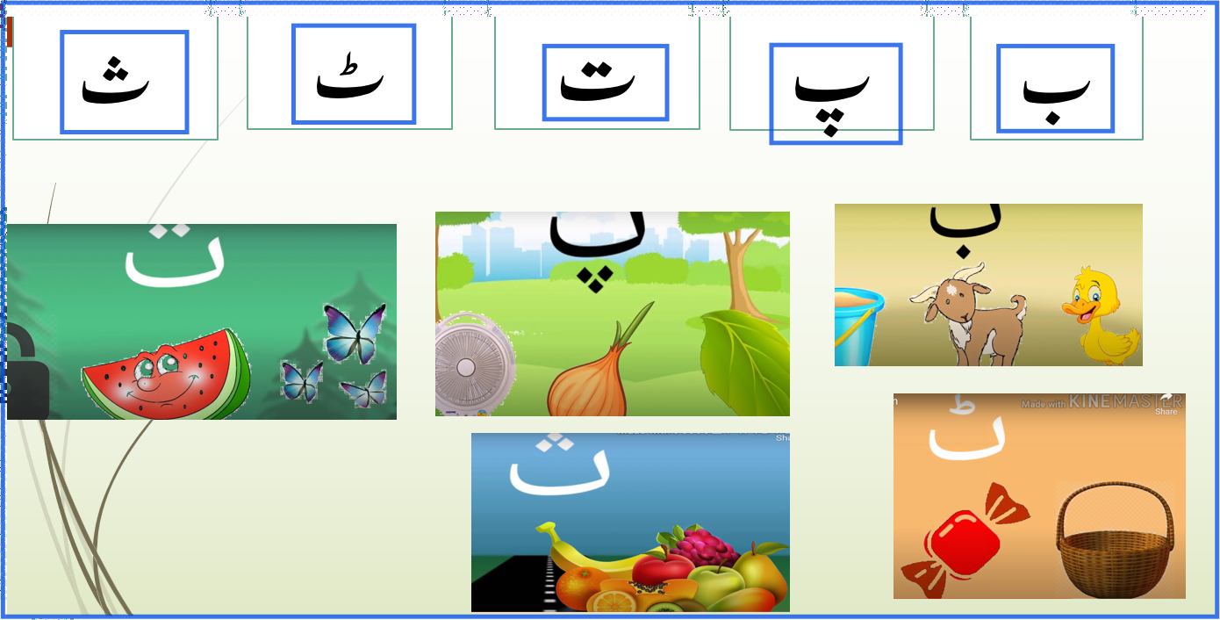
Urdu alphabets ب کا خاندان ۔ حروف تہجی - YouTubeAlif, Bay Phonics Song with Zabar Sounds | Full and Short Form Urdu Alphabet Letters with Zabar - YouTube
Alif, Bay, Pay Song| Urdu Alphabet Song – YouTube
AlphaLearn Urdu bets Part 2 | اردو حروف تہجی سیکھئے - YouTube

Slide 6
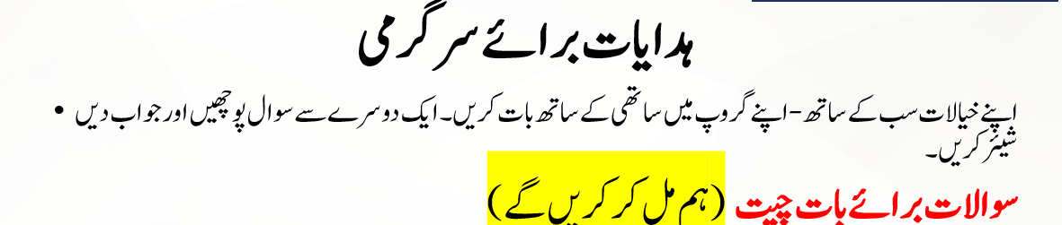










Slide 7



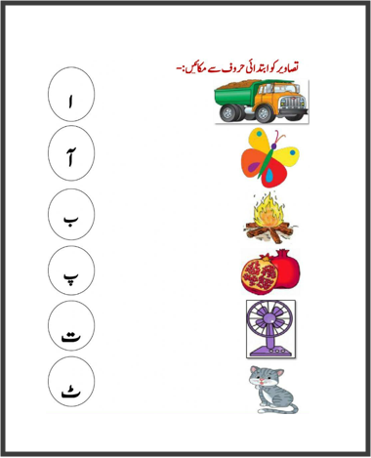
ہدایت: جوابات اور جملوں کو صاف اور مکمل لکھیئے-
 | خالی جگہ پر کریں ( ث،ب،ت)- Fill in the blanks ا ـــــ پ ـــــ ٹ ـــــــ ملائیے:- Match | حرف جوڑئیے Join the letters 1- ب / ط/ خ 2- پ/ی/ا/ز 3- ت/ر/ب/و/ز 4- ٹ/و/ک/ڑ/ی 5- ث/م/ر
ث | ب
ت | پ
ب | ت
پ | ث

Slide 8
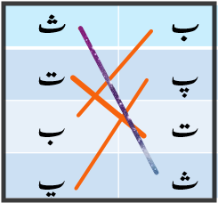







ہدایت: جوابات اور جملوں کو صاف اور مکمل لکھیئے-
 | خالی جگہ پر کریں ( ث،ب،ت)- Fill in the blanks ا ـــــ پ ـــــ ٹ ـــــــ ملائیے:- Match | حرف جوڑئیے Join the letters 1- ب / ط/ خ----بطخ 2- پ/ی/ا/ز----پیاز 3- ت/ر/ب/و/ز--- تربوز 4- ٹ/و/ک/ڑ/ی----ٹوکڑی 5- ث/م/ر----- ثمر

Slide 9

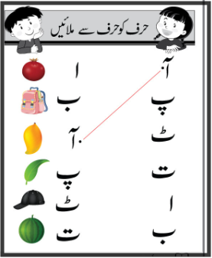
ہدایت:کلاس سے جانے سے پہلےحرف ملائیے

Slide 10
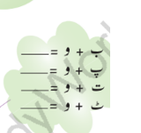
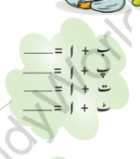
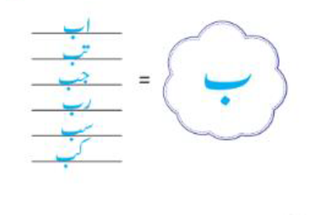

Slide 11
Thank you

Slide 12
Learn Like a GEM
Subject: URDU
Lesson:حروف تہجی ( ج کا خاندان)
Date: 21-9-2026

Slide 13
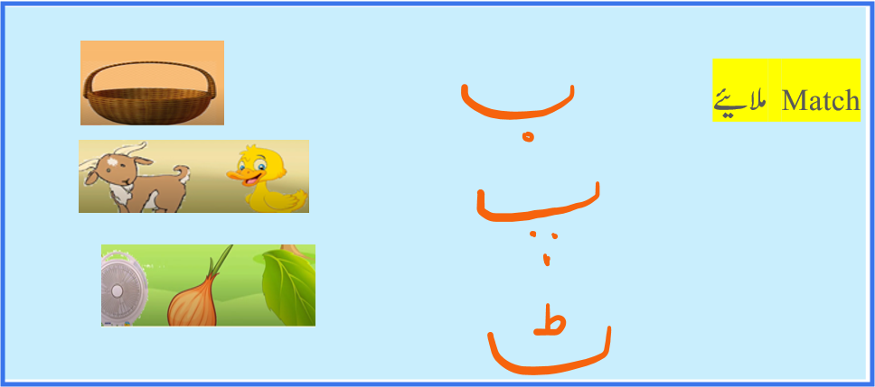
Notes:
Prepare relevant tasks – Design a short (3–5 min) retrieval task that prompts active recall from memory, drawing on knowledge from the last lesson, previous units, and/or prerequisite content
Display clearly – Ensure the task is visible and ready for students as they enter the classroom/start the lesson
Establish a routine – Consistently have students start the Do Now immediately without prompting, making it a seamless part of the classroom culture
Monitor and guide – Circulate the room while students work, offering support where needed
Review quickly – Once completed, briefly go over the activity to address misconceptions, share correct answers, or engage students in peer or self-assessment

Slide 14



Notes:
Prepare relevant tasks – Design a short (3–5 min) retrieval task that prompts active recall from memory, drawing on knowledge from the last lesson, previous units, and/or prerequisite content
Display clearly – Ensure the task is visible and ready for students as they enter the classroom/start the lesson
Establish a routine – Consistently have students start the Do Now immediately without prompting, making it a seamless part of the classroom culture
Monitor and guide – Circulate the room while students work, offering support where needed
Review quickly – Once completed, briefly go over the activity to address misconceptions, share correct answers, or engage students in peer or self-assessment

Slide 15

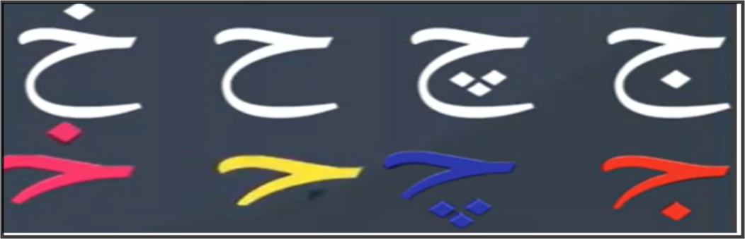
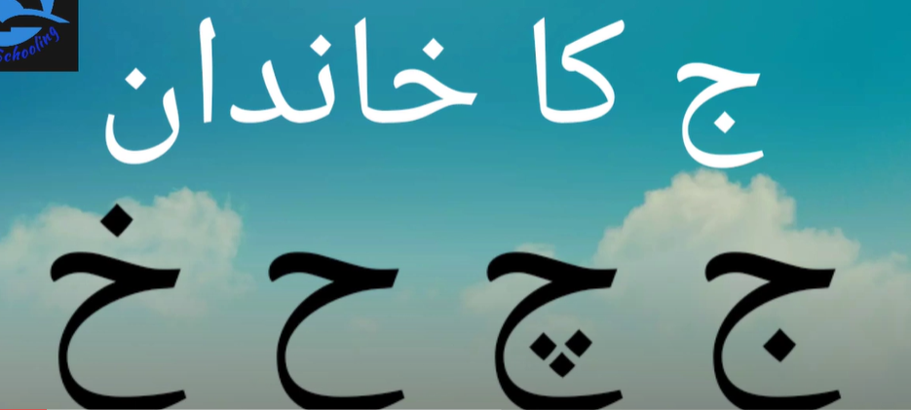
نتائج
ج کا خاندان
ج سے خ تک کی آواز اور حرف میں فرق سمجھ سکیں گے۔
 | حروف تہجی
Jeem | ج
Che | چ
Hae | ح
Khe | خ
Notes:
Learning Outcomes
Identify the desired skill – Determine the specific skill or ability students should demonstrate by the end of the lesson. Start with “By the end of this lesson, you will be able to (verb)…”
Align with knowledge components – Consider the knowledge necessary to achieve the learning outcome and apply the skill effectively
Communicate the outcome – Share the learning outcome at the start of the lesson, ensuring students understand what they are working towards
To Know
Create a clear list – Develop a concise list of the knowledge components when planning the lesson
Introduce the components – Present the knowledge components at the beginning of the lesson, clearly explaining the importance of each component, how they connect to one another and directly support in achieving the learning outcome
Integrate into instruction – Incorporate the knowledge components throughout the lesson, reinforcing them during discussions, activities, and assessments

Slide 16
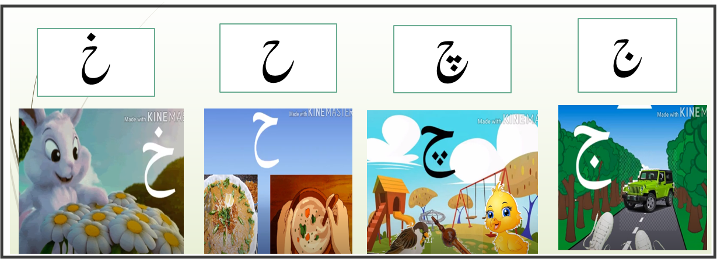

Slide 17
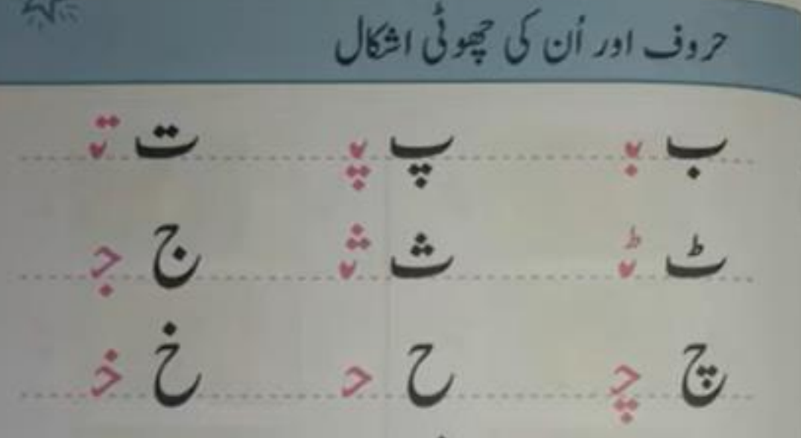

Slide 18








غبارے بنا کر اس میں ج کے خاندان کے حروف لکھیئے-

Slide 19
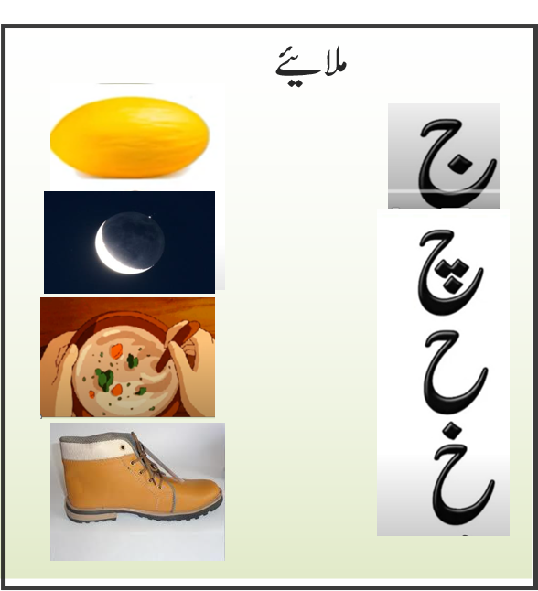
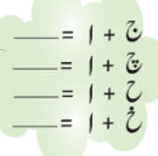
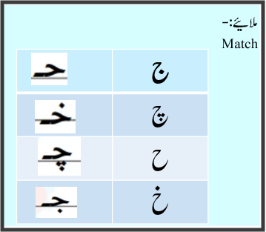
ہدایت: جوابات اور جملوں کو صاف اور مکمل لکھیئے-
 | ملائیے:- Match | حرف توڑئیے Separate the letters 1- جیپ 2-چڑیا 3- حلوہ 4- خرگوش 5-چاند 6-جوتا
Join the letters
حروف جوڑئیے
 | ج
 | چ
 | ح
 | خ

Slide 20









ہدایت: جوابات اور جملوں کو صاف اور مکمل لکھیئے-
 | ملائیے:- Match | حرف توڑئیے Separate the letters 1- جیپ 2-چڑیا 3- حلوہ 4- خرگوش 5-چاند 6-جوتا
Join the letters
حروف جوڑئیے
ج/ی/پ
چ/ڑ/ی/ا
 | ج
 | چ
 | ح
 | خ
ح/ل/و/ہ
خ/ر/گ/و/ش
چ/ا/ن/د
ج/و/ت/ا

Slide 21
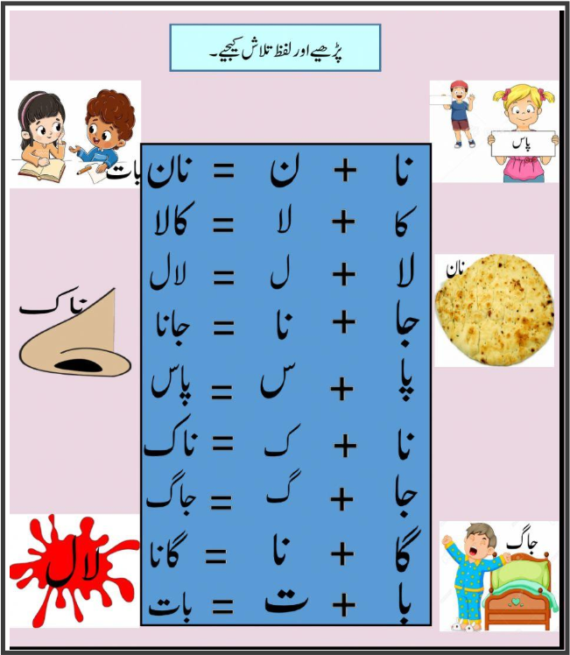
ہدایت:کلاس سے جانے سے پہلے کوئ دو الفاظ پڑھ کر تلاش کریں -

