Slide 1
Live Lesson
Non- Negotiables

Slide 2

Guidelines for Remote Learning
Live Lessons - إرشادات التعلم عن بعد
While using the Virtual platform, the following guidelines are essential to be followed to make learning meaningful.
يجب اتباع التعليمات الآتية عند التعلم عن بعد
👩‍🎓 STUDENTS | الطلاب
👕 Dress appropriately.
ارتدِ ملابس مناسبة ومحتشمة .
🎤 🎥 Keep microphone muted. Keep camera ON.
يرجى كتم الصوت وتشغيل الكاميرا .
🤝 Respect others and take turns.
احترم الآخرين وأنتظر دورك.
Ensure you select blur or professional background view.
يرجى التأكد من اختيار الخلفية الضبابية لشاشة الحاسوب .
🔐 Protect your personal information and account details. Do not share your ID and Password details with anyone.
احمِ معلوماتك الشخصية وتفاصيل حسابك. لا تشارك رقم التعريف (ID) وكلمة المرور الخاصة بك مع أي شخص.
👨‍👩‍👧 PARENTS | أولياء الأمور
🌱 Encourage independent learning.
شجع طفلك على التعلم المسنقل
💙 Support your child emotionally.
قدم لطفلك الدعم العاطفي
📧 Email teachers for questions.
راسل المعلم عبر البريد الإلكتروني عند وجود استفسار.
⏰ Avoid interrupting live lessons.
تجنب مقاطعة الحصص اثناء البث المباشر .
🛡️ Ensure a safe learning environment at home.
وفر بيئة تعلم آمنة في المنزل.

Slide 3
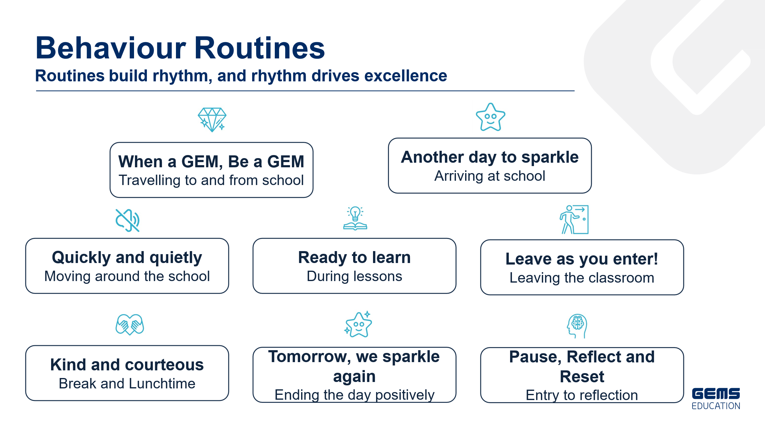
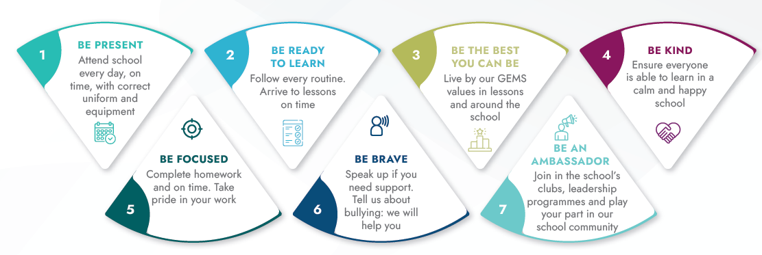
Be a GEM

Slide 4
Learn Like a GEM
Subject: French
Lesson: .Unite 3_D’où vient ton tee-shirt..
Date: …Le Lundi 6 Avril 2026

Slide 5

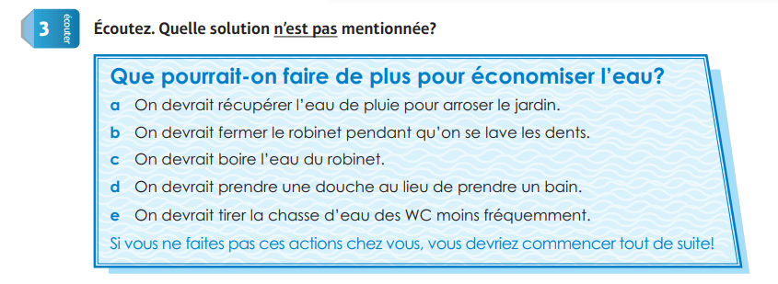
5 min
Notes:
Prepare relevant tasks – Design a short (3–5 min) retrieval task that prompts active recall from memory, drawing on knowledge from the last lesson, previous units, and/or prerequisite content
Display clearly – Ensure the task is visible and ready for students as they enter the classroom/start the lesson
Establish a routine – Consistently have students start the Do Now immediately without prompting, making it a seamless part of the classroom culture
Monitor and guide – Circulate the room while students work, offering support where needed
Review quickly – Once completed, briefly go over the activity to address misconceptions, share correct answers, or engage students in peer or self-assessment

Slide 6


Notes:
Set clear expectations – Before students begin work, outline the task and explain what a strong response looks like, ensuring students understand what you will be looking for
Circulate strategically – Move around the classroom deliberately, ensuring that all students know you will be checking their work to offer real-time support; position yourself where you can observe multiple students at once
Offer praise and actionable feedback – Offer specific guidance and encourage independence by fostering self-correction and deeper thinking (name error, ask them to revise it, follow up); give quick feedback (symbols, code, colour)
Follow up – Return to students to see if they implemented your feedback and made progress

Slide 7
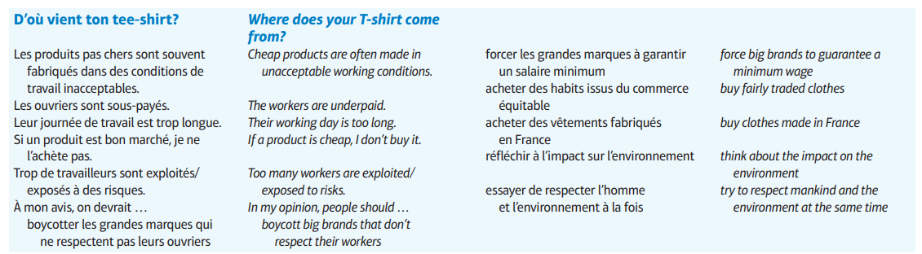

A la fin de la leçon, les étudiants Pourront
Les vocabulaires
Comprendre à utiliser la voix passive
Notes:
Learning Outcomes
Identify the desired skill – Determine the specific skill or ability students should demonstrate by the end of the lesson. Start with “By the end of this lesson, you will be able to (verb)…”
Align with knowledge components – Consider the knowledge necessary to achieve the learning outcome and apply the skill effectively
Communicate the outcome – Share the learning outcome at the start of the lesson, ensuring students understand what they are working towards
To Know
Create a clear list – Develop a concise list of the knowledge components when planning the lesson
Introduce the components – Present the knowledge components at the beginning of the lesson, clearly explaining the importance of each component, how they connect to one another and directly support in achieving the learning outcome
Integrate into instruction – Incorporate the knowledge components throughout the lesson, reinforcing them during discussions, activities, and assessments

Slide 8
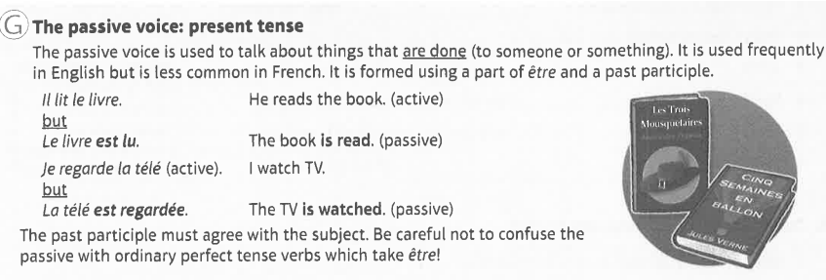
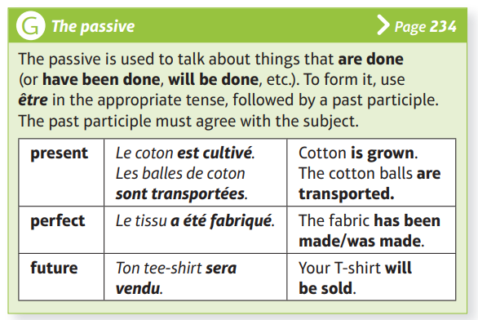
Notes:
Model the task (I Do) – Demonstrate the skill while thinking aloud and naming the steps; model your thinking and not just the procedure

Slide 9

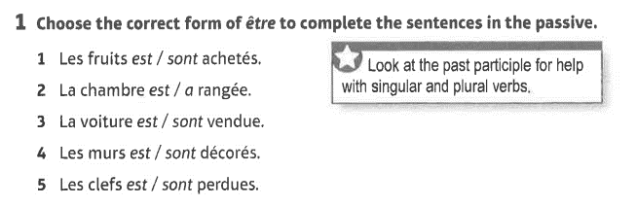
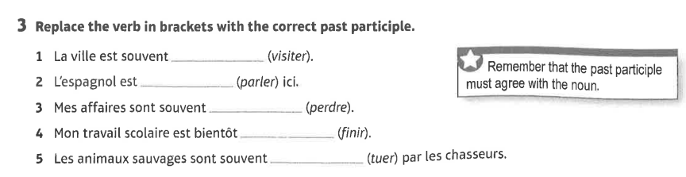
5 min
Notes:
Engage in guided practice (We Do) – Work together with students using another example; ask questions, probe thinking, provide prompts, and give feedback. Be explicit about what students should be doing during this stage

Slide 10


Notes:
Set clear expectations – Before students begin work, outline the task and explain what a strong response looks like, ensuring students understand what you will be looking for
Circulate strategically – Move around the classroom deliberately, ensuring that all students know you will be checking their work to offer real-time support; position yourself where you can observe multiple students at once
Offer praise and actionable feedback – Offer specific guidance and encourage independence by fostering self-correction and deeper thinking (name error, ask them to revise it, follow up); give quick feedback (symbols, code, colour)
Follow up – Return to students to see if they implemented your feedback and made progress

Slide 11


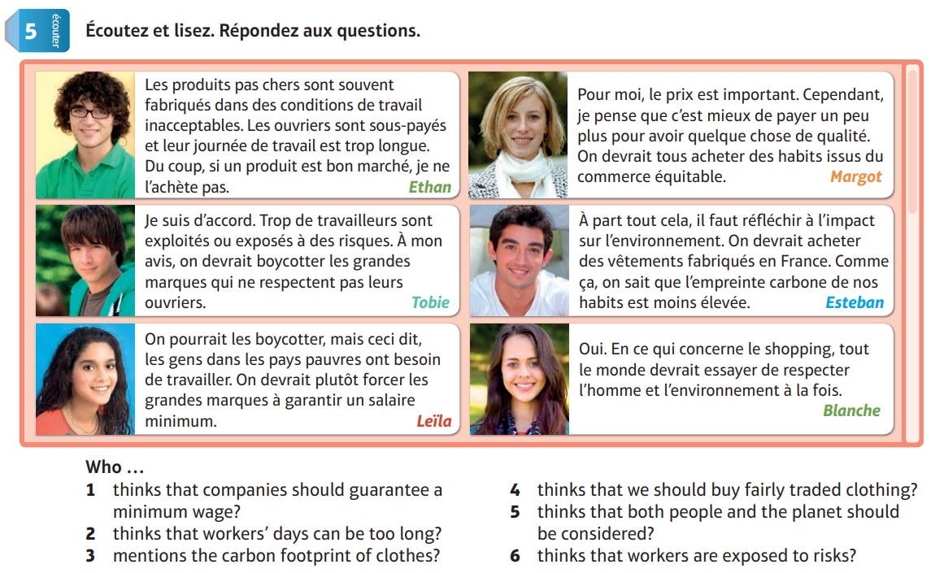
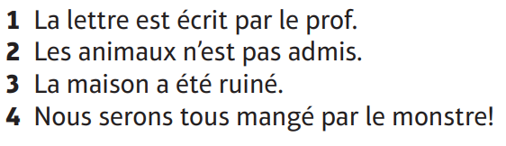
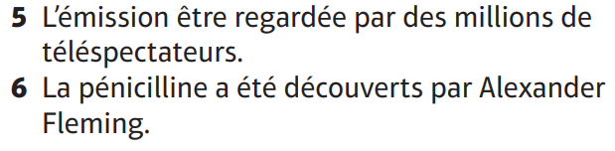
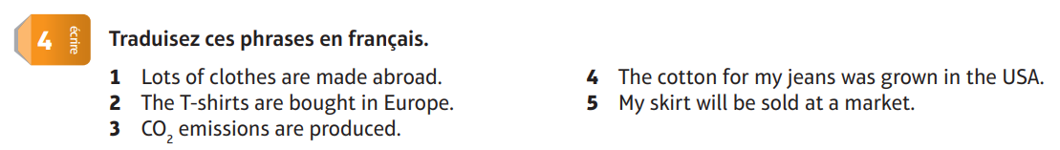

10 min
Group A
Group B
Group C
Notes:
Facilitate independent practice (You Do) – Allow students to complete the task independently, providing minimal guidance. Use Affirmative Checking and offer constructive feedback to reinforce learning and address any misconceptions

Slide 12
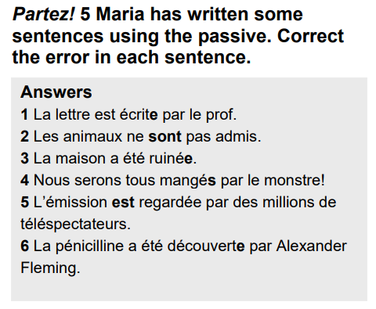
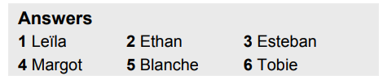
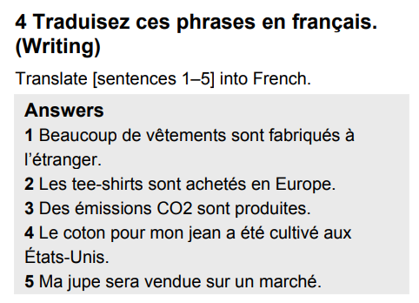
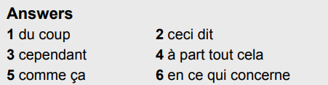
Notes:
Set clear expectations – Before students begin work, outline the task and explain what a strong response looks like, ensuring students understand what you will be looking for
Circulate strategically – Move around the classroom deliberately, ensuring that all students know you will be checking their work to offer real-time support; position yourself where you can observe multiple students at once
Offer praise and actionable feedback – Offer specific guidance and encourage independence by fostering self-correction and deeper thinking (name error, ask them to revise it, follow up); give quick feedback (symbols, code, colour)
Follow up – Return to students to see if they implemented your feedback and made progress

Slide 13
La voix passive Quiz
Notes:
1. Create targeted questions – Design no more than 1-3 brief and focused questions/prompts that assess the lesson’s core knowledge or skills
2. Distribute at the end – Share the exit tickets at the end of the lesson, ensuring everyone completes them
3. Collect and review – Gather responses and quickly analyse responses to gauge overall understanding and individual student needs
4. Provide feedback – Use the exit ticket data to give immediate feedback
5. Plan next steps – Adapt future lessons based on patterns or misconceptions identified through the exit tickets

Slide 14
Thank you

