Slide 1
Learn Like a GEM
Subject: BIOLOGY
Lesson: Tropisms & Homeostasis. Revision
Date: Wednesday, June 17, 2026

Slide 2
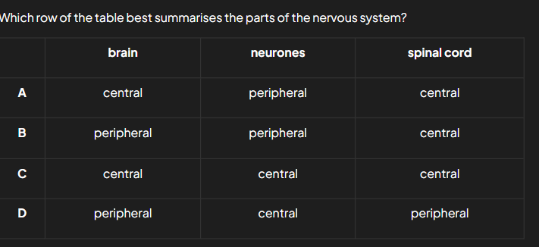
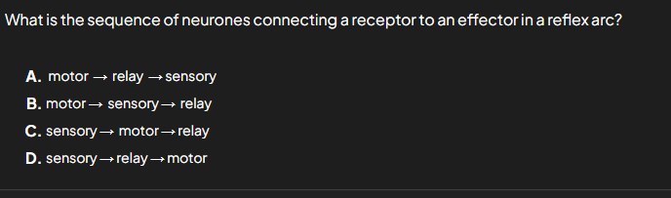
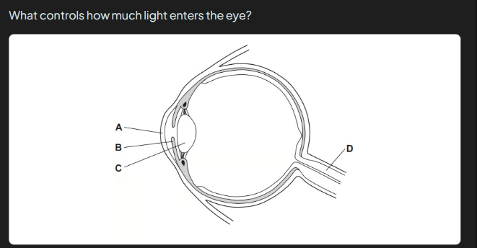
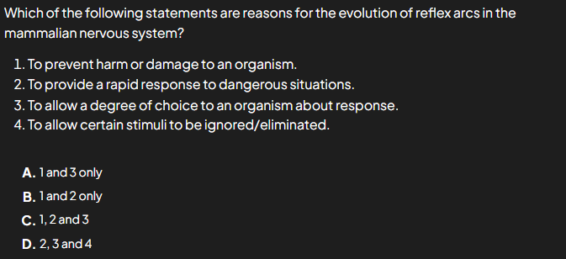


5 MINS
Notes:
Prepare relevant tasks – Design a short (3–5 min) retrieval task that prompts active recall from memory, drawing on knowledge from the last lesson, previous units, and/or prerequisite content
Display clearly – Ensure the task is visible and ready for students as they enter the classroom/start the lesson
Establish a routine – Consistently have students start the Do Now immediately without prompting, making it a seamless part of the classroom culture
Monitor and guide – Circulate the room while students work, offering support where needed
Review quickly – Once completed, briefly go over the activity to address misconceptions, share correct answers, or engage students in peer or self-assessment

Slide 3
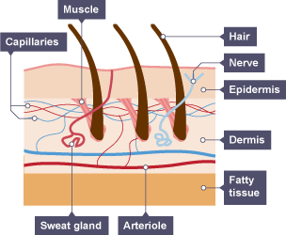
By the end of the lesson, students will be able to explain how the body regulates it’s normal functions through homeostasis.
Notes:
Learning Outcomes
Identify the desired skill – Determine the specific skill or ability students should demonstrate by the end of the lesson. Start with “By the end of this lesson, you will be able to (verb)…”
Align with knowledge components – Consider the knowledge necessary to achieve the learning outcome and apply the skill effectively
Communicate the outcome – Share the learning outcome at the start of the lesson, ensuring students understand what they are working towards
To Know
Create a clear list – Develop a concise list of the knowledge components when planning the lesson
Introduce the components – Present the knowledge components at the beginning of the lesson, clearly explaining the importance of each component, how they connect to one another and directly support in achieving the learning outcome
Integrate into instruction – Incorporate the knowledge components throughout the lesson, reinforcing them during discussions, activities, and assessments

Slide 4
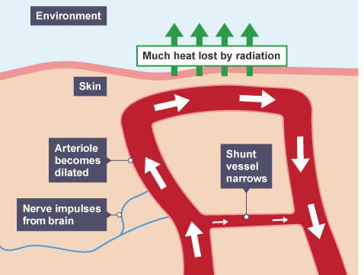
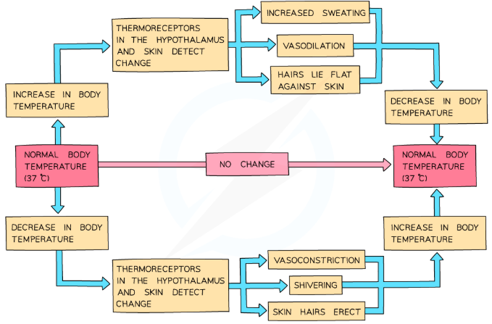
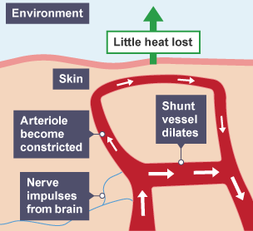
Thermoregulation

Slide 5
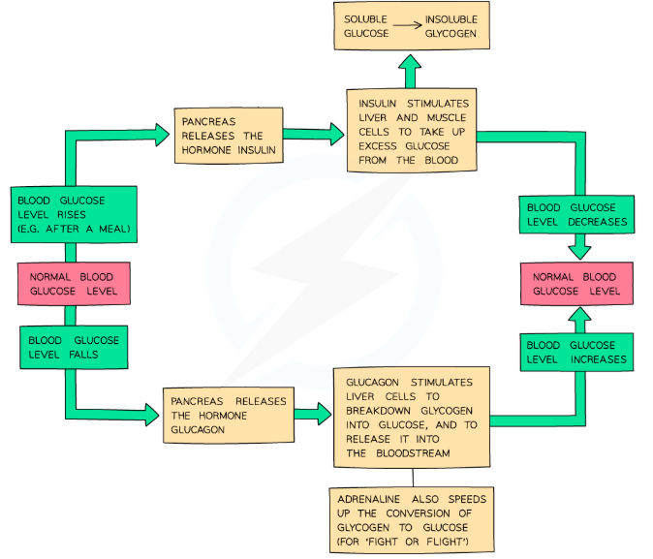
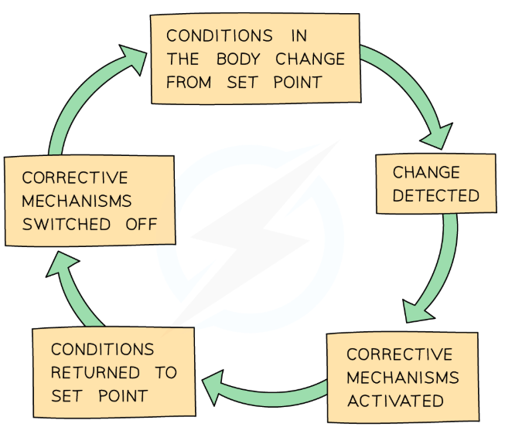
Blood Glucose Regulation

Slide 6
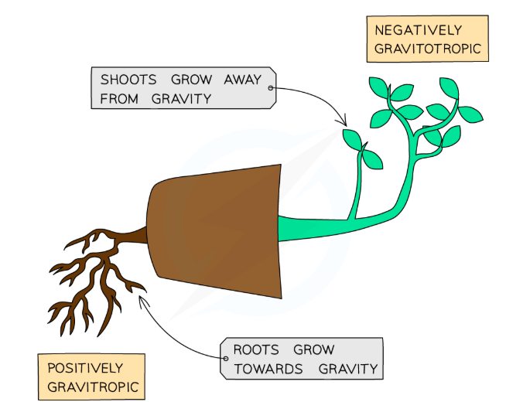
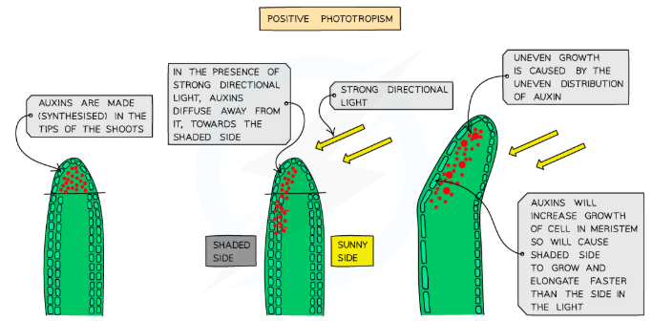
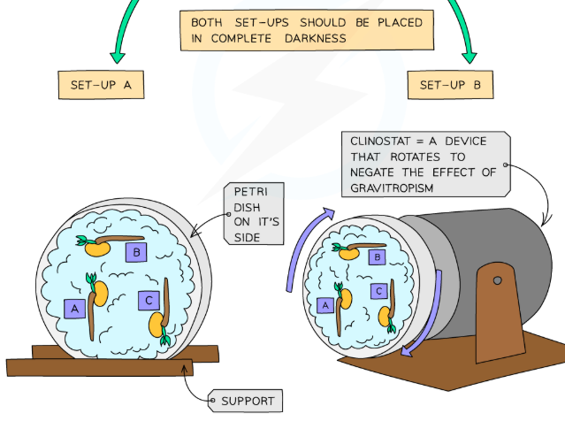
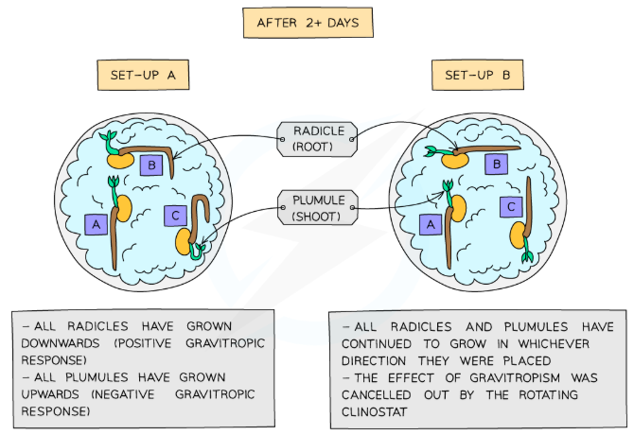
Tropisms

Slide 7
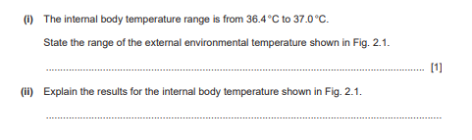
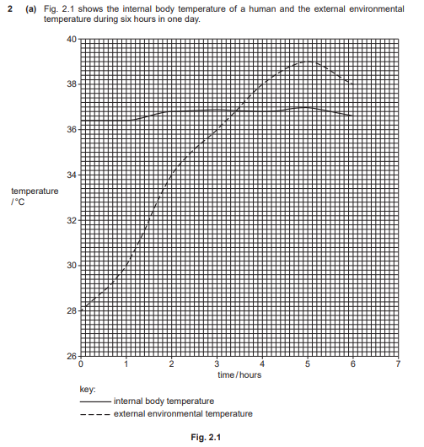
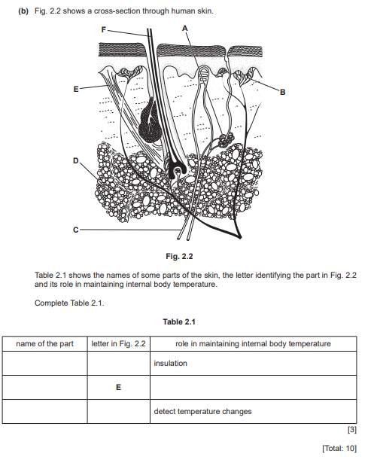
Notes:
Engage in guided practice (We Do) – Work together with students using another example; ask questions, probe thinking, provide prompts, and give feedback. Be explicit about what students should be doing during this stage

Slide 8
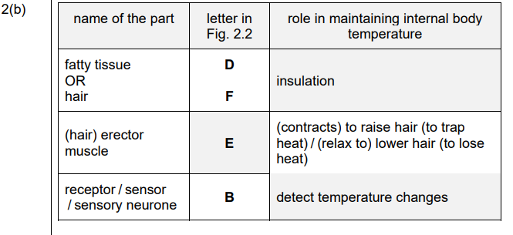
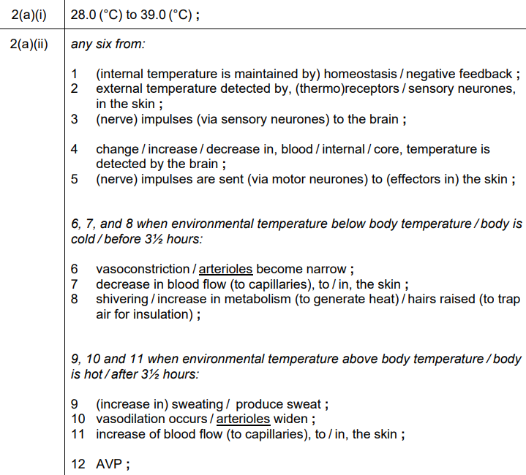
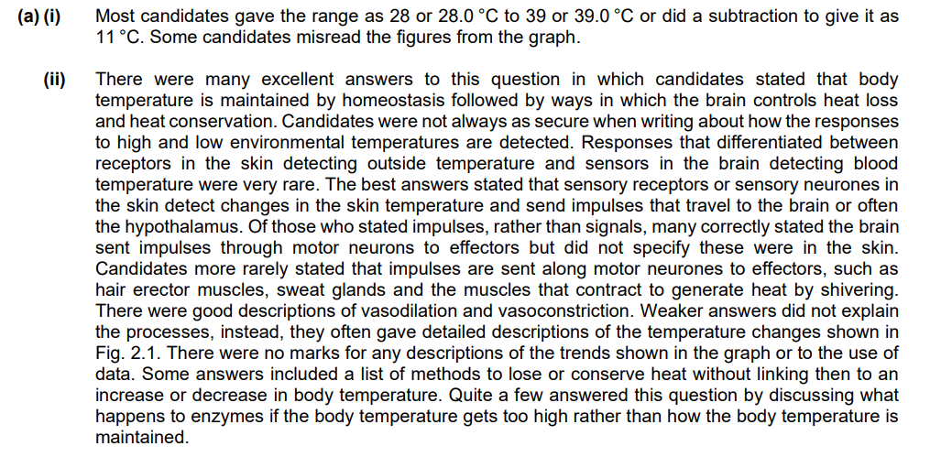

Notes:
Set clear expectations – Before students begin work, outline the task and explain what a strong response looks like, ensuring students understand what you will be looking for
Circulate strategically – Move around the classroom deliberately, ensuring that all students know you will be checking their work to offer real-time support; position yourself where you can observe multiple students at once
Offer praise and actionable feedback – Offer specific guidance and encourage independence by fostering self-correction and deeper thinking (name error, ask them to revise it, follow up); give quick feedback (symbols, code, colour)
Follow up – Return to students to see if they implemented your feedback and made progress

Slide 9
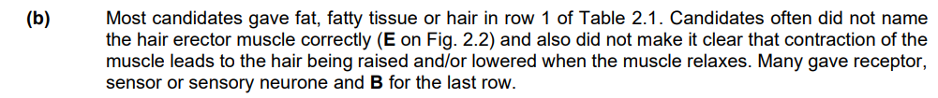
Notes:
Set clear expectations – Before students begin work, outline the task and explain what a strong response looks like, ensuring students understand what you will be looking for
Circulate strategically – Move around the classroom deliberately, ensuring that all students know you will be checking their work to offer real-time support; position yourself where you can observe multiple students at once
Offer praise and actionable feedback – Offer specific guidance and encourage independence by fostering self-correction and deeper thinking (name error, ask them to revise it, follow up); give quick feedback (symbols, code, colour)
Follow up – Return to students to see if they implemented your feedback and made progress

Slide 10
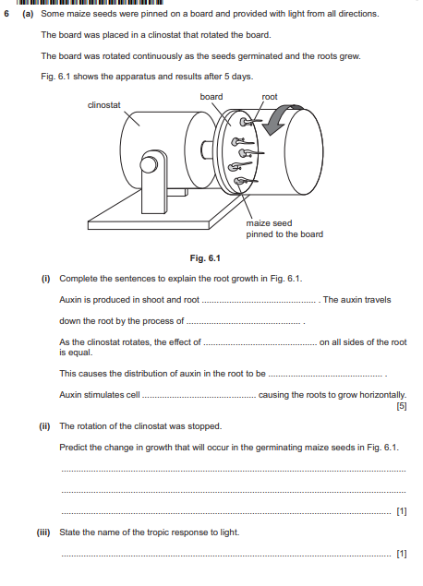
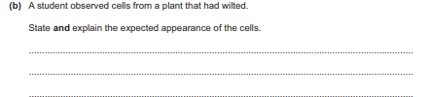
Notes:
Facilitate independent practice (You Do) – Allow students to complete the task independently, providing minimal guidance. Use Affirmative Checking and offer constructive feedback to reinforce learning and address any misconceptions

Slide 11

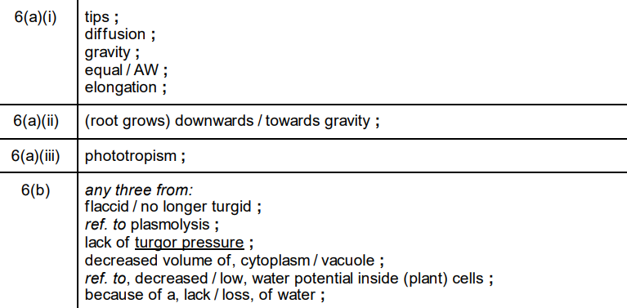
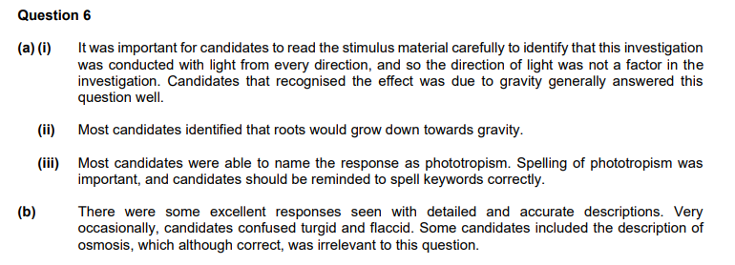


Slide 12
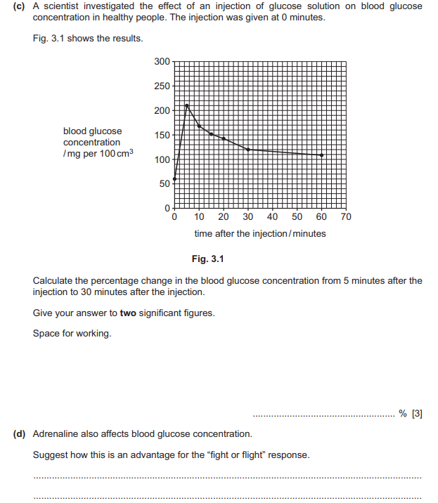
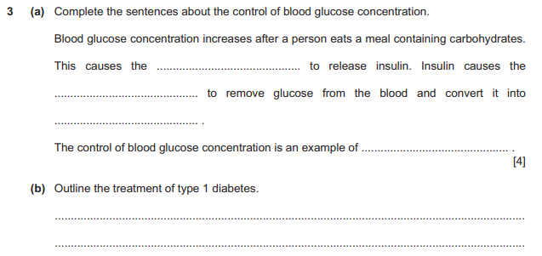
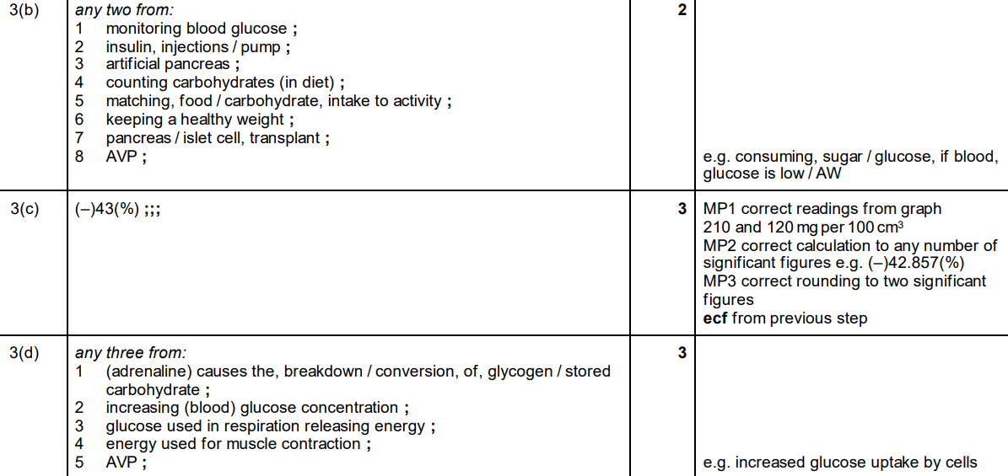
Notes:
Facilitate independent practice (You Do) – Allow students to complete the task independently, providing minimal guidance. Use Affirmative Checking and offer constructive feedback to reinforce learning and address any misconceptions

Slide 13
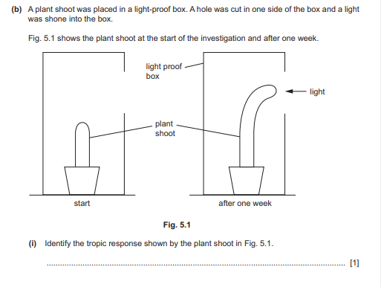
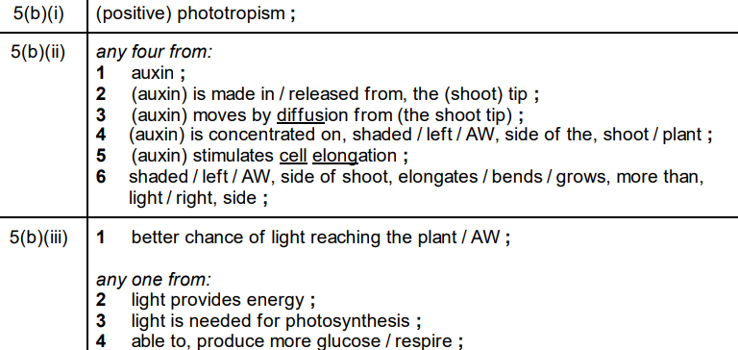
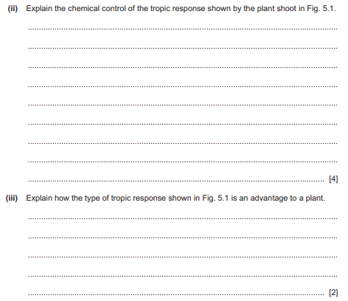
Notes:
Facilitate independent practice (You Do) – Allow students to complete the task independently, providing minimal guidance. Use Affirmative Checking and offer constructive feedback to reinforce learning and address any misconceptions

Slide 14
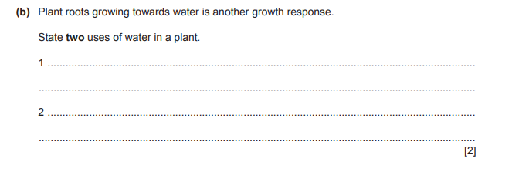
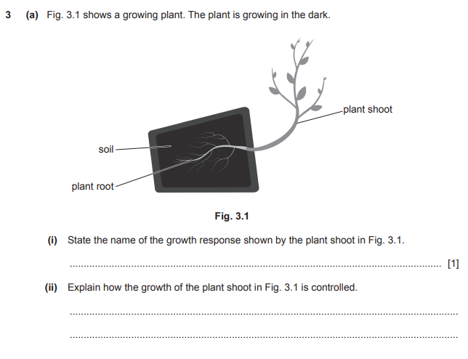
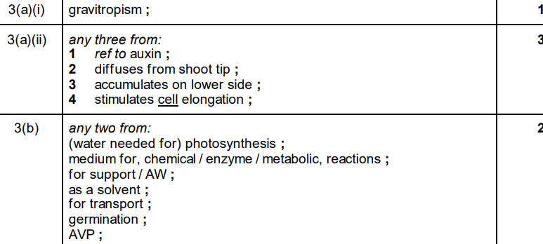
Notes:
Facilitate independent practice (You Do) – Allow students to complete the task independently, providing minimal guidance. Use Affirmative Checking and offer constructive feedback to reinforce learning and address any misconceptions

Slide 15
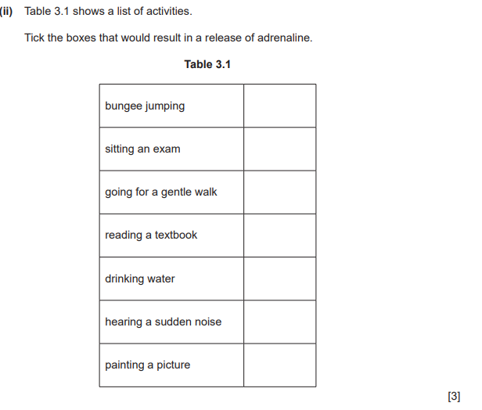
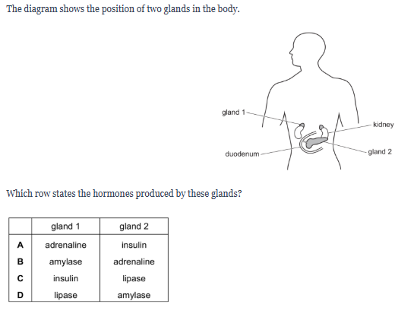
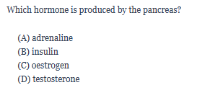
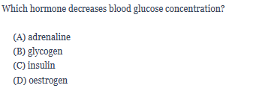










Notes:
1. Create targeted questions – Design no more than 1-3 brief and focused questions/prompts that assess the lesson’s core knowledge or skills
2. Distribute at the end – Share the exit tickets at the end of the lesson, ensuring everyone completes them
3. Collect and review – Gather responses and quickly analyse responses to gauge overall understanding and individual student needs
4. Provide feedback – Use the exit ticket data to give immediate feedback
5. Plan next steps – Adapt future lessons based on patterns or misconceptions identified through the exit tickets

Slide 16
Thank you

