Slide 1
Learn Like a GEM
Subject: Math
Lesson: Measuring Area
Date: (insert date here)

Slide 2

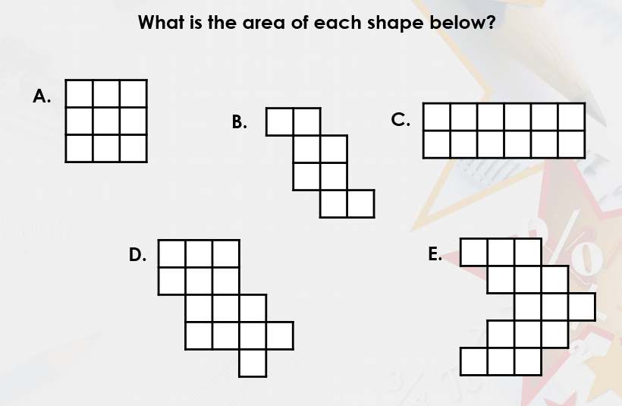

Notes:
Prepare relevant tasks – Design a short (3–5 min) retrieval task that prompts active recall from memory, drawing on knowledge from the last lesson, previous units, and/or prerequisite content
Display clearly – Ensure the task is visible and ready for students as they enter the classroom/start the lesson
Establish a routine – Consistently have students start the Do Now immediately without prompting, making it a seamless part of the classroom culture
Monitor and guide – Circulate the room while students work, offering support where needed
Review quickly – Once completed, briefly go over the activity to address misconceptions, share correct answers, or engage students in peer or self-assessment

Slide 3
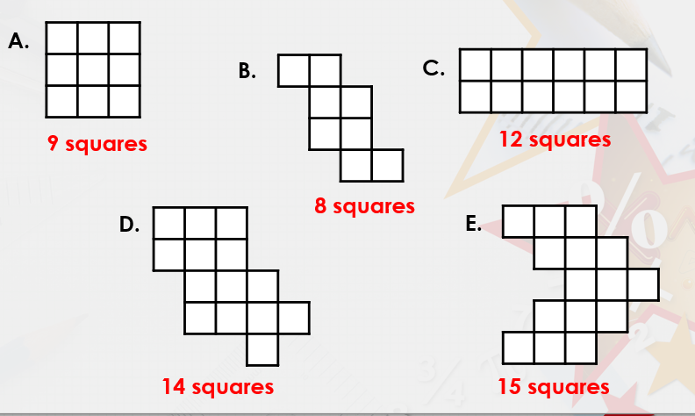
SELF EVALUATION
Notes:
Prepare relevant tasks – Design a short (3–5 min) retrieval task that prompts active recall from memory, drawing on knowledge from the last lesson, previous units, and/or prerequisite content
Display clearly – Ensure the task is visible and ready for students as they enter the classroom/start the lesson
Establish a routine – Consistently have students start the Do Now immediately without prompting, making it a seamless part of the classroom culture
Monitor and guide – Circulate the room while students work, offering support where needed
Review quickly – Once completed, briefly go over the activity to address misconceptions, share correct answers, or engage students in peer or self-assessment

Slide 4

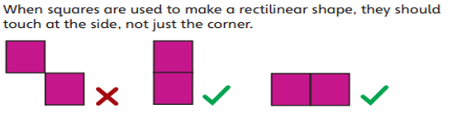
Topic: Measure area
Key word
By the end of this lesson, you students will be able to,
apply the knowledge of measuring area for making shapes with given areas
Notes:
Learning Outcomes
Identify the desired skill – Determine the specific skill or ability students should demonstrate by the end of the lesson. Start with “By the end of this lesson, you will be able to (verb)…”
Align with knowledge components – Consider the knowledge necessary to achieve the learning outcome and apply the skill effectively
Communicate the outcome – Share the learning outcome at the start of the lesson, ensuring students understand what they are working towards
To Know
Create a clear list – Develop a concise list of the knowledge components when planning the lesson
Introduce the components – Present the knowledge components at the beginning of the lesson, clearly explaining the importance of each component, how they connect to one another and directly support in achieving the learning outcome
Integrate into instruction – Incorporate the knowledge components throughout the lesson, reinforcing them during discussions, activities, and assessments

Slide 5

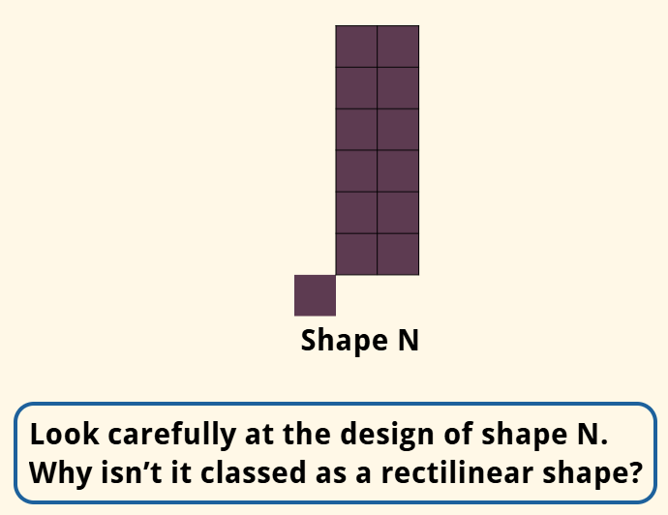
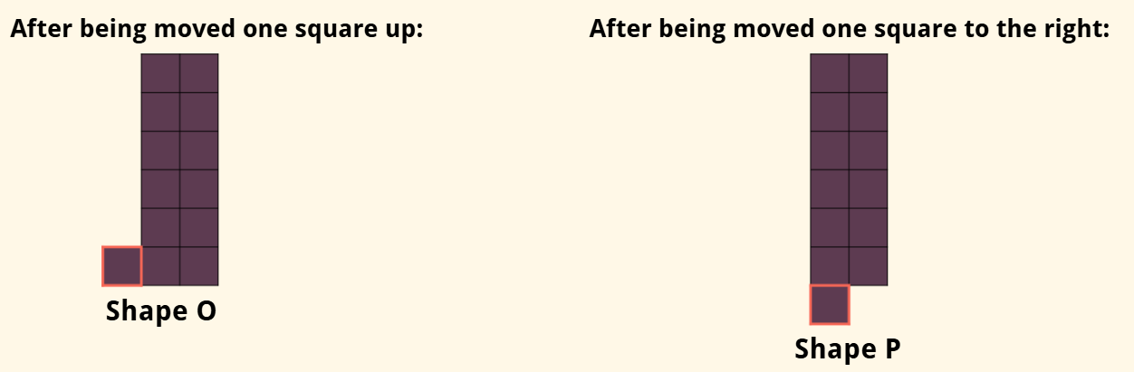
Shape N is made up of 13 identical squares which all touch each other. None of the squares overlap.
It isn’t a rectilinear shape because none of the sides of the square at the bottom left touch any of the sides of the other squares. Only two corners touch.
With rectilinear shapes, it is very important that the side of each square touches at least one side of another square.
LO: Apply the knowledge of measuring area for making shapes with given areas.
Notes:
Model the task (I Do) – Demonstrate the skill while thinking aloud and naming the steps; model your thinking and not just the procedure

Slide 6

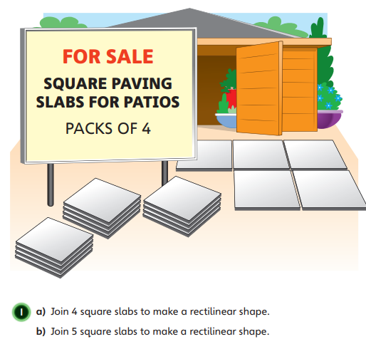
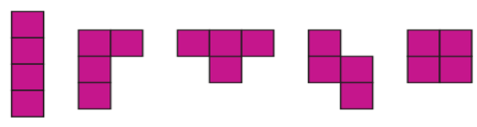
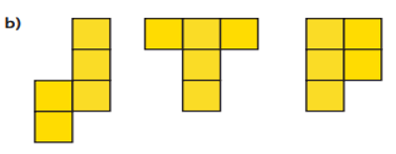
Use the Geo board using the given link. Geoboard | Free Virtual Manipulatives | Toy Theater or https://www.activelearnprimary.co.uk/resource/709413
LO: Apply the knowledge of measuring area for making shapes with given areas.
Notes:
Model the task (I Do) – Demonstrate the skill while thinking aloud and naming the steps; model your thinking and not just the procedure
Engage in guided practice (We Do) – Work together with students using another example; ask questions, probe thinking, provide prompts, and give feedback. Be explicit about what students should be doing during this stage
Facilitate independent practice (You Do) – Allow students to complete the task independently, providing minimal guidance. Use Affirmative Checking and offer constructive feedback to reinforce learning and address any misconceptions

Slide 7
Must: In your notebook
Challage-1
1-Draw 3 different rectilinear shapes with an area of 8 squares.
Challage-2
2- Draw 3 different rectilinear shapes with an area of 16 squares.
Challage-3
3- Draw 3 different rectilinear shapes with an area of 24 squares.
LO: Apply the knowledge of measuring area for making shapes with given areas.
Notes:
Facilitate independent practice (You Do) – Allow students to complete the task independently, providing minimal guidance. Use Affirmative Checking and offer constructive feedback to reinforce learning and address any misconceptions

Slide 8
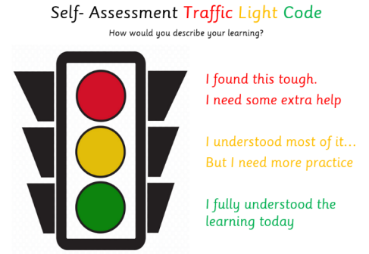
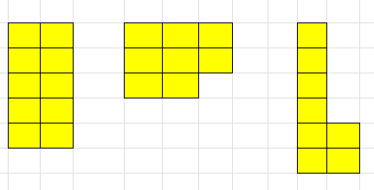
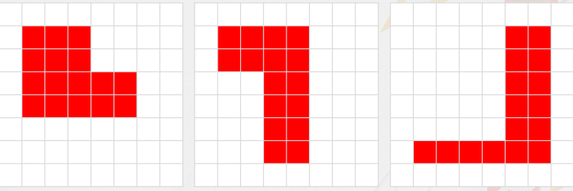
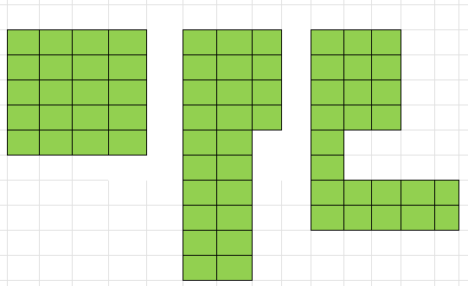
Challage-1
Challage-2
Challage-3
LO: Apply the knowledge of measuring area for making shapes with given areas.
Notes:
Set clear expectations – Before students begin work, outline the task and explain what a strong response looks like, ensuring students understand what you will be looking for
Circulate strategically – Move around the classroom deliberately, ensuring that all students know you will be checking their work to offer real-time support; position yourself where you can observe multiple students at once
Offer praise and actionable feedback – Offer specific guidance and encourage independence by fostering self-correction and deeper thinking (name error, ask them to revise it, follow up); give quick feedback (symbols, code, colour)
Follow up – Return to students to see if they implemented your feedback and made progress

Slide 9
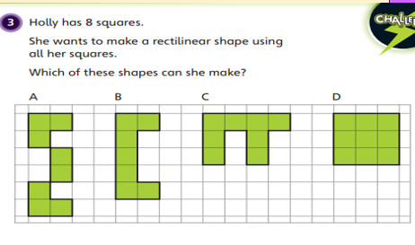

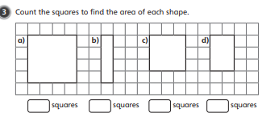
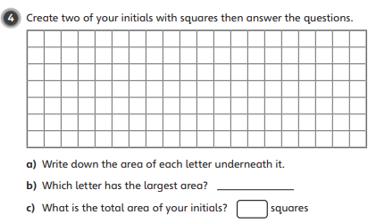
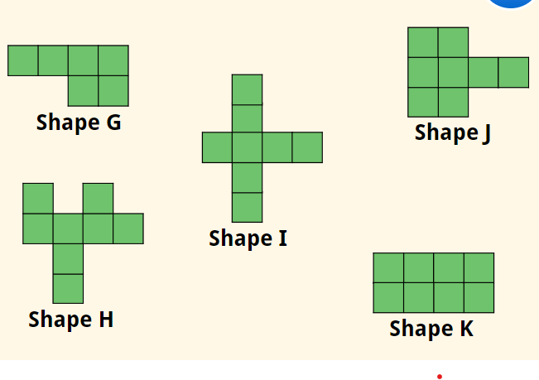
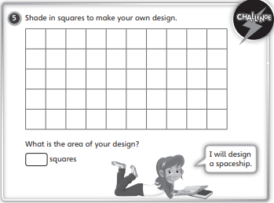
Independent task-Practice Book Page 118,119,120
Understand
Analyze
Page 119 Q3
Evaluate
Apply
If two squares are removed from each rectilinear shape below, which shapes will have 6 identical squares?
Create
LO: Apply the knowledge of measuring area for making shapes with given areas.
Notes:
Facilitate independent practice (You Do) – Allow students to complete the task independently, providing minimal guidance. Use Affirmative Checking and offer constructive feedback to reinforce learning and address any misconceptions

Slide 10
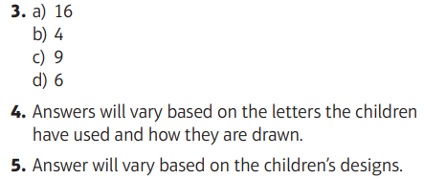





Understand
Apply
Create
Analyze
Evaluate
LO: Apply the knowledge of measuring area for making shapes with given areas.
Notes:
Set clear expectations – Before students begin work, outline the task and explain what a strong response looks like, ensuring students understand what you will be looking for
Circulate strategically – Move around the classroom deliberately, ensuring that all students know you will be checking their work to offer real-time support; position yourself where you can observe multiple students at once
Offer praise and actionable feedback – Offer specific guidance and encourage independence by fostering self-correction and deeper thinking (name error, ask them to revise it, follow up); give quick feedback (symbols, code, colour)
Follow up – Return to students to see if they implemented your feedback and made progress

Slide 11
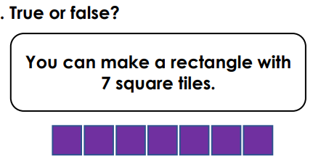
LO: Apply the knowledge of measuring area for making shapes with given areas.
Notes:
1. Create targeted questions – Design no more than 1-3 brief and focused questions/prompts that assess the lesson’s core knowledge or skills
2. Distribute at the end – Share the exit tickets at the end of the lesson, ensuring everyone completes them
3. Collect and review – Gather responses and quickly analyse responses to gauge overall understanding and individual student needs
4. Provide feedback – Use the exit ticket data to give immediate feedback
5. Plan next steps – Adapt future lessons based on patterns or misconceptions identified through the exit tickets

Slide 12
Thank you

